Slide 1

Scalable Fast Rank-1 Dictionary Learning for fMRI Big Data Analysis
Milad Makkie¹, Xiang Li*², Binbin Lin³, Mojtaba Sedigh Fazli¹, Ian Davidson³,
Jieping Ye², Tianming Liu¹, Shannon Quinn¹
¹Department of Computer Science, University of Georgia, Athens, GA
²Clincial Data Science Center, Massachusetts General Hospital, Harvard Medical School, Boston, MA
³Department of Computational Medicine and Bioinformatics, University of Michigan, Ann Arbor, MI
³D
http://cs.uga.edu/~mila

Slide 2
Introduction
Algorithm
Parallelization
Deployment
Result and Performance
Functional Network Discovery by Matrix Decomposition
Data-driven approaches for discovering underlying functional organization patterns;
“Functional Networks” as components from matrix decomposition/factorization analysis: collection of voxels;
Temporal and spatial patterns are defined in the matrix decomposition results (i.e. components and loading coefficient);
Widely-applied in fMRI studies: ICA, PCA, dictionary learning;

Slide 3
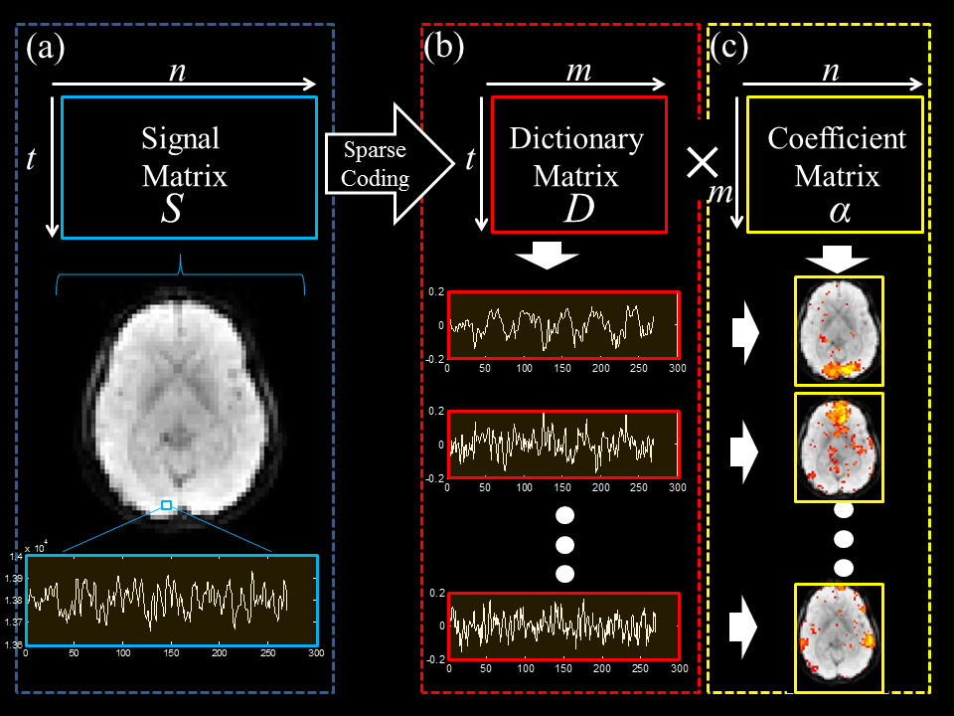
Introduction
Algorithm
Parallelization
Deployment
Result and Performance
Dictionary Learning Method
Temporal variation patterns stored in D matrix;
Spatial distribution patterns stored in α (mixing) matrix;
m number of dictionaries (functional networks) learned;
“Sparse Representation of Whole-brain FMRI Signals for Identification of Functional Networks”, Medical Image Analysis, 2014

Slide 4
Introduction
Algorithm
Parallelization
Deployment
Result and Performance
Functional Network Discovery by Matrix Decomposition
Both task-evoked (e.g. M1, M3, M5) and resting-state networks (e.g. RSN2, RSN 3) could be identified from the dictionary learning results;
“Sparse Representation of Whole-brain FMRI Signals for Identification of Functional Networks”, Medical Image Analysis, 2014

Slide 5
Introduction
Algorithm
Parallelization
Deployment
Result and Performance
Functional Network Discovery by Matrix Decomposition
“Holistic Atlases of Functional Networks and Interactions Reveal Reciprocal Organizational Architecture of Cortical Function”, IEEE Transactions on Biomedical Engineering, 2015

Slide 6
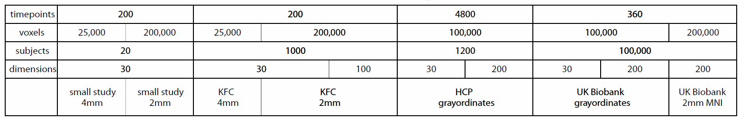
Introduction
Algorithm
Parallelization
Deployment
Result and Performance
Working with Big Data
fMRI big data posed grand challenges on the analysis methods: data size quickly out-grows the memory capacity and computational power;
Utilizing population-level data for learning the holistic brain functional networks space rather than the dominant features: overcome the bias and false-positives in traditional hypothesis-based studies;
Requires integrated informatics system and the fast and scalable algorithms for high-throughput neuroimaging researches;
“Group-PCA for very large fMRI datasets”, Smith et. al, Neuroimaging, 2015

Slide 7
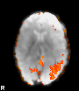
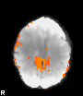
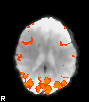
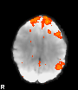
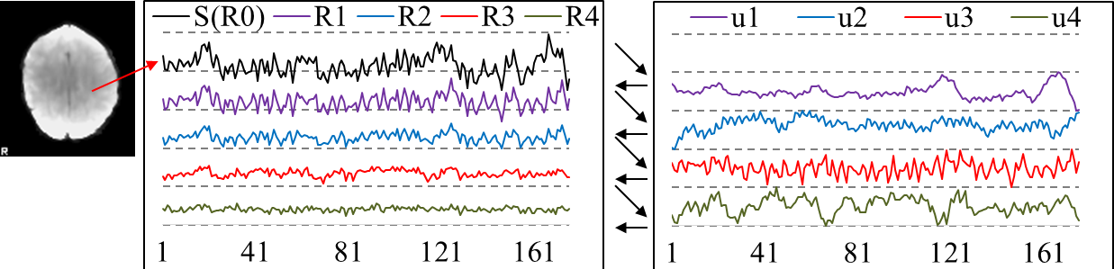
Introduction
Algorithm
Parallelization
Deployment
Result and Performance
Rank-1 Dictionary Learning Overview
R⁰ = S
R¹ = R⁰-u¹v^{1T}
R^{K} = R^{K-1}-u^{K}v^{K}’
deflate
=
=
…
=
u¹
×
v¹
u²
×
v²
u^{K}
×
v^{K}
Dictionary matrix (temporal) U
Loading coefficient matrix (spatial) V
u¹
u²
u³
…
u^{K}
…
v¹
v²
v³
v^{K}
“Fast and Scalable Rank-1 Dictionary Learning for Inferring Brain Networks from fMRI Data”, IEEE Transactions on Medical Imaging, in submission

Slide 8
Introduction
Algorithm
Parallelization
Deployment
Result and Performance
Rank-1 Dictionary Learning Overview
General formulation of matrix factorization problem:
$$\frac{1}{2}||S−Dα||+ψ\left(α\right)$$
Dictionary learning with l-0 constraint (u and v are vectors):
$$L\left(u, v\right)={\left\|S−uv^{T}\right\|}_{F}, s.t. \left\|u\right\|=1, {\left\|v\right\|}_{0}≤r.$$
Alternating Least Square (ALS) updating:
$$v={\underset{v}{argmin}\left\|S−uv^{T}\right\|}_{F}={\left(u^{T}S\right)}^{T}, s.t. {\left|v\right|}_{0}≤r,$$
$$u={\underset{u}{argmin}\left\|S−uv^{T}\right\|}_{F}=\frac{Sv}{\left\|Sv\right\|},$$
$$Converging at step j if: \left\|u^{j+1}−u^{j}\right\|<ε, ε=0.01.$$
Deflation:
$$R^{n}=R^{n−1}−uv^{T}, R^{0}=S,1<n≤K,$$

Slide 9
Introduction
Algorithm
Parallelization
Deployment
Result and Performance
Distributed r1DL based on Spark
reduce(lambda function)
Controller node (worker)
map(function)
Slave node (worker)
Slave node (worker)
Slave node (worker)
Subroutines for Parallelization
Vector-matrix multiplication;
Matrix-vector multiplication;
Matrix deflation;

Slide 10
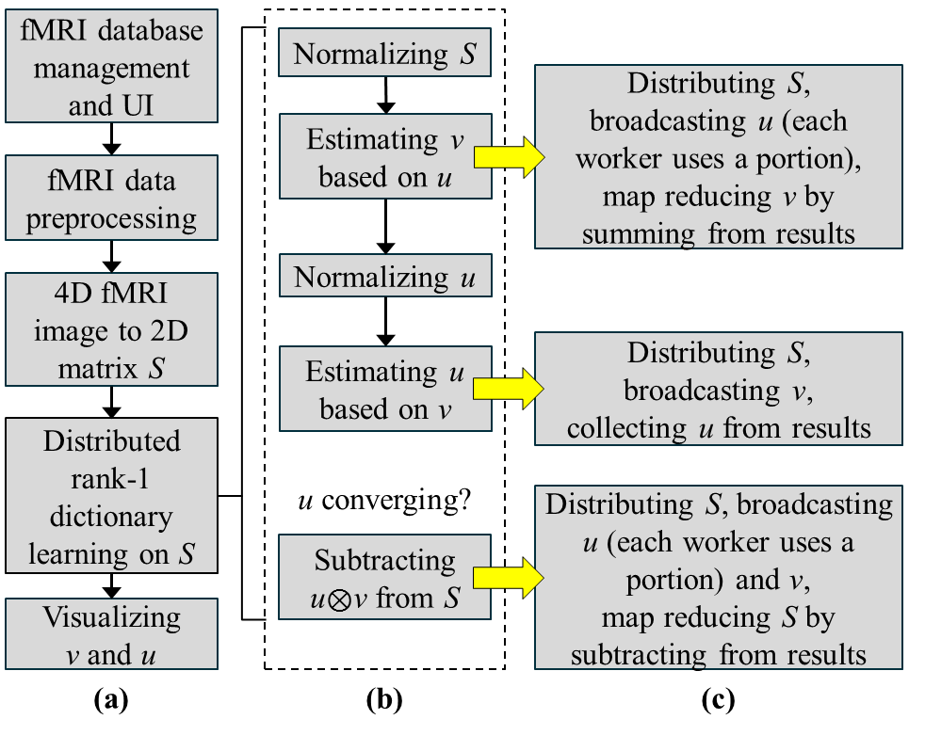
Introduction
Algorithm
Parallelization
Deployment
Result and Performance
Distributed r1DL based on Spark

Slide 11
Introduction
Algorithm
Parallelization
Deployment
Result and Performance
Current parallelization implementations
Import S
…
Imported on-demand as small portions, maintained at HDFS
R⁰=S / S=R^{k}
…
Each node reads its corresponding portion of S
v=uS
…
Each node receives u, only uses portion of u for calculating v, then summed up v at controller node
v=topR(v)
…
Divide&conquer for partitioning v, distributed at each node
u=Sv
…
Each node receives v, generates portion of u, then collected at controller node
R^{k}=R^{k-1}-uv
…
Broadcasting v and u, then summed up the total residual at controller node

Slide 12
Introduction
Algorithm
Parallelization
Deployment
Result and Performance
Deployment of r1DL and D-r1DL
r1DL is implemented in C++, MATLAB and Python. Currently it can be run locally or through our HELPNI web service:
http://bd.hafni.cs.uga.edu/HELPNI/
D-r1DL is implemented in Spark (Python). It has been experimentally deployed in:
Our in-house server (will be linked to HELPNI soon);
Georgia Advanced Computing Resource Center (GACRC) server: 48 cores, 128 GB memory http://gacrc.uga.edu/;
Amazon Elastic Compute Cloud (AWS-EC2) service;

Slide 13
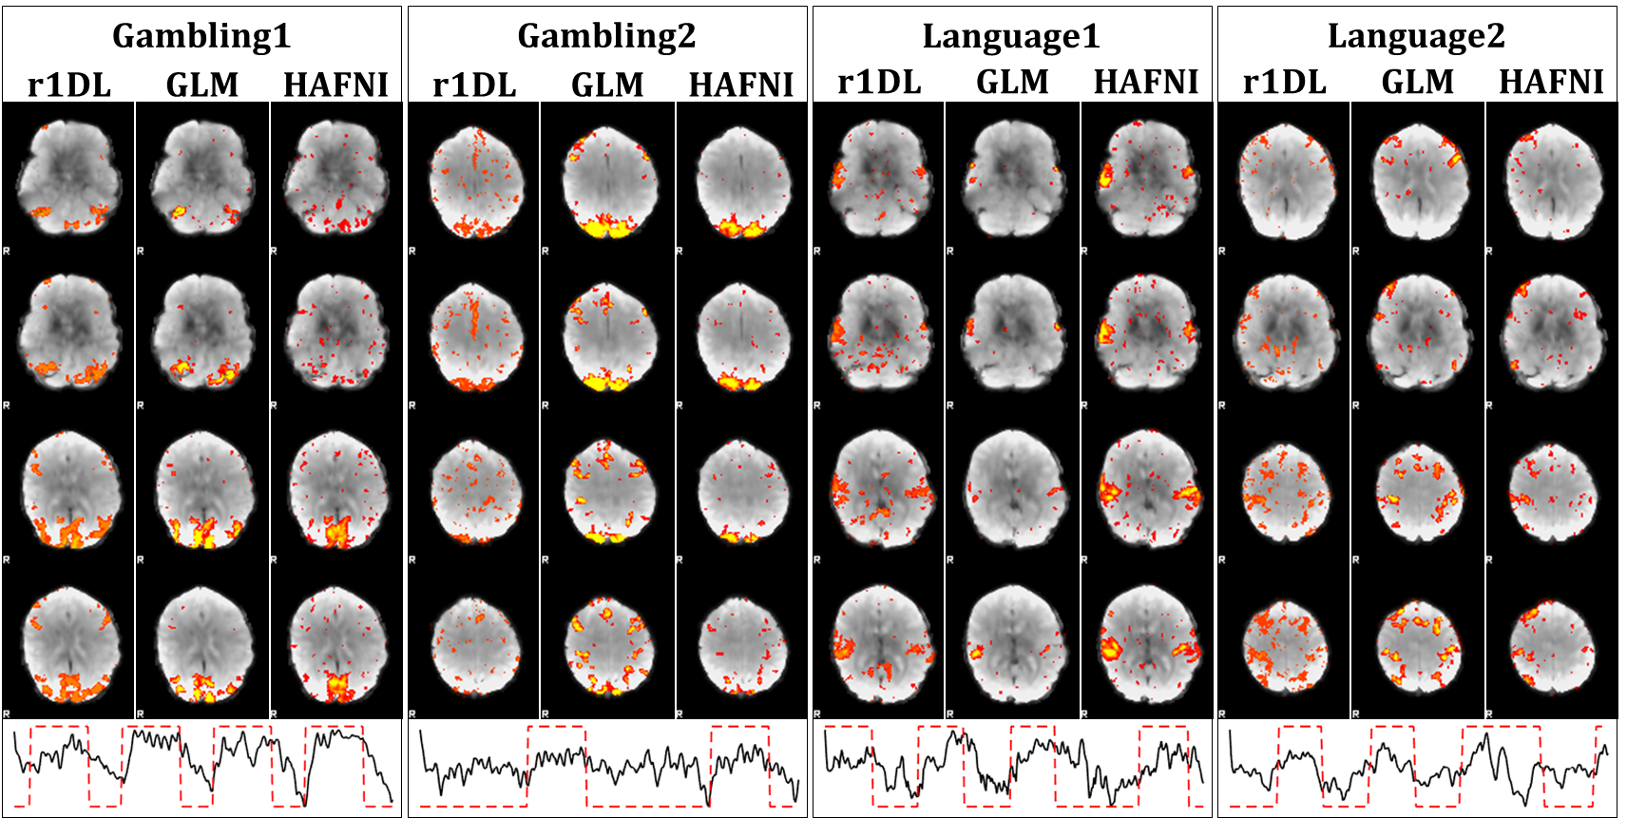
Introduction
Algorithm
Parallelization
Deployment
Result and Performance
Results by r1DL on Human Connectome Project data
Scalable Fast Rank-1 Dictionary Learning for fMRI Big Data Analysis, KDD 2016

Slide 14
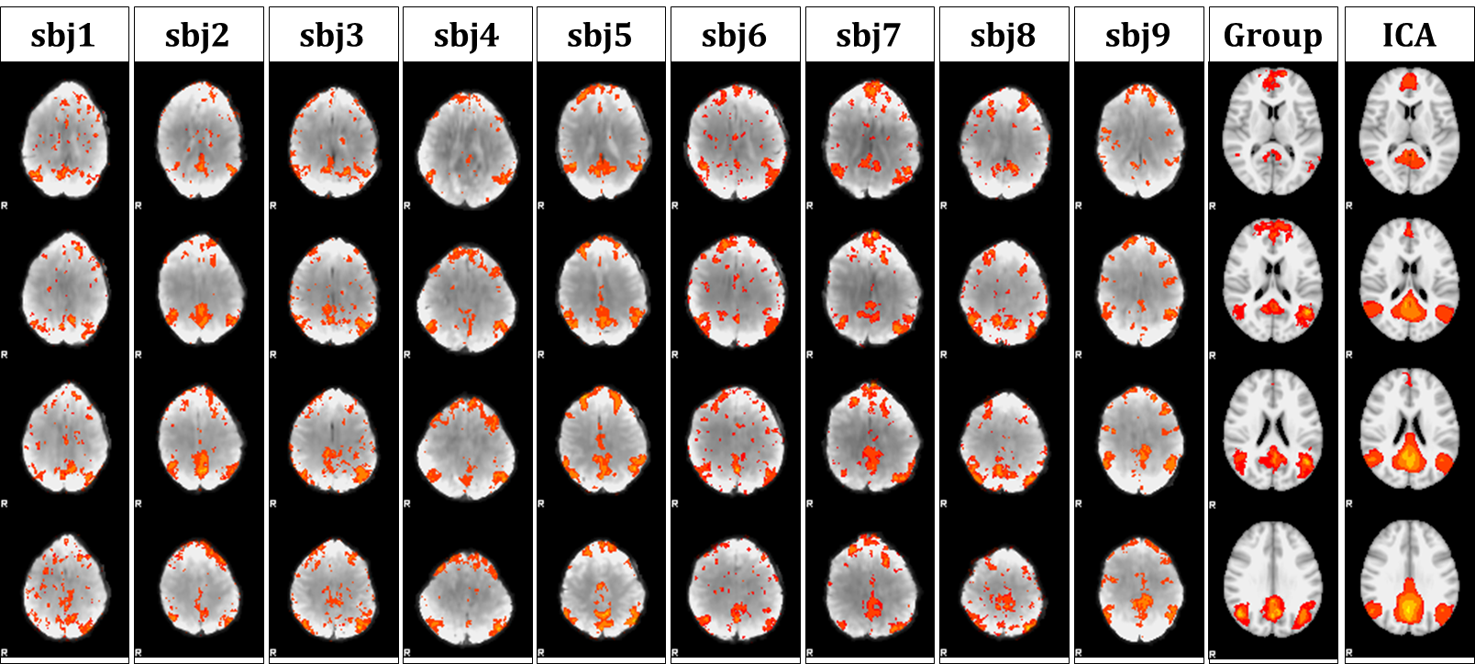
Introduction
Algorithm
Parallelization
Deployment
Result and Performance
Results by r1DL on Human Connectome Project data
Scalable Fast Rank-1 Dictionary Learning for fMRI Big Data Analysis, KDD 2016

Slide 15
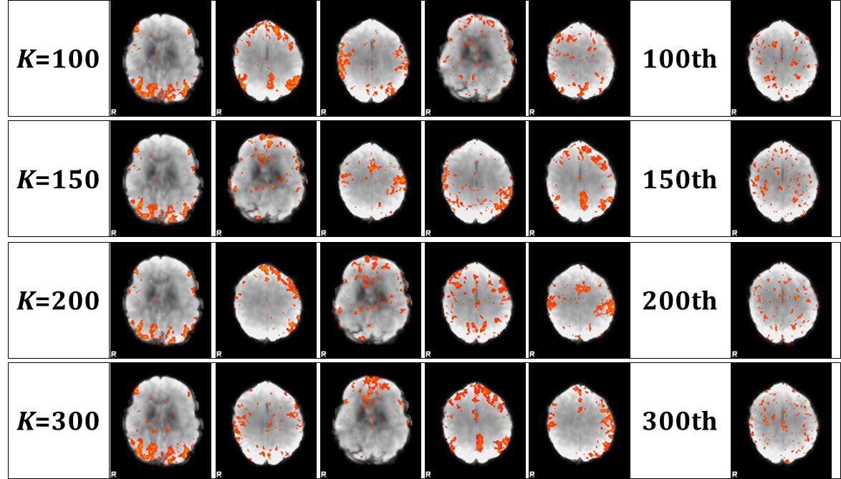
Introduction
Algorithm
Parallelization
Deployment
Result and Performance
Atom Cardinality and Decreasing Variation in Residual
Scalable Fast Rank-1 Dictionary Learning for fMRI Big Data Analysis, KDD 2016

Slide 16
Introduction
Algorithm
Parallelization
Result and Performance
Deployment
Atom Cardinality and Decreasing Variation in Residual
Performance comparison
Scalable Fast Rank-1 Dictionary Learning for fMRI Big Data Analysis, KDD 2016

Slide 17
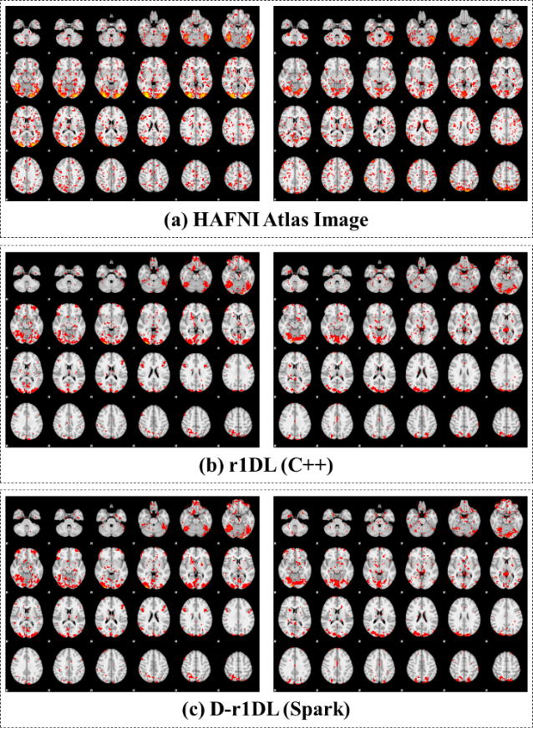
Introduction
Algorithm
Parallelization
Deployment
Result and Performance
Performance statistics by D-r1DL

Slide 18
Introduction
Algorithm
Parallelization
Deployment
Result and Performance
Performance statistics by D-r1DL
Memory cost of D-r1DL by using the resilient distributed dataset (RDD) supported by Spark could be constant, regardless of the size of the input;
Nodes working on data partitions rather than the whole dataset;
Scalable Fast Rank-1 Dictionary Learning for fMRI Big Data Analysis, KDD 2016

Slide 19
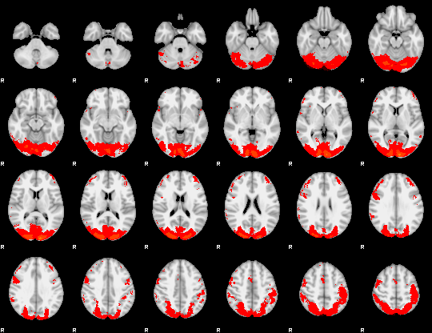
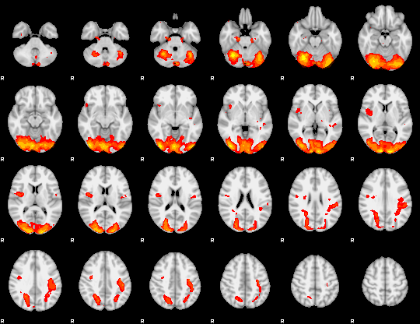
Introduction
Algorithm
Parallelization
Deployment
Result and Performance
Large-scale fMRI (>20 GB) analysis
Group-wise tfMRI data aggregated from 68 subjects: 176×15,228,260 input matrix;
Scalable Fast Rank-1 Dictionary Learning for fMRI Big Data Analysis, KDD 2016

Slide 20
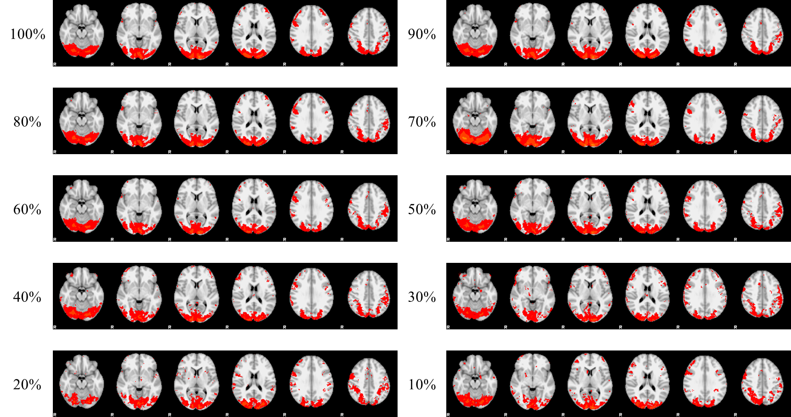
Introduction
Algorithm
Parallelization
Deployment
Result and Performance
Large-scale fMRI (>20 GB) analysis with sampling

Slide 21
Introduction
Algorithm
Parallelization
Deployment
Result and Performance
Conclusion and Discussion
Fast and scalable solution for big neuroimaging data analysis;
Not limited to fMRI data: a general framework for all modalities of biomedical imaging data;
Getting more comprehensive understanding of the brain functional dynamics: precisely mapping individual functional networks to the population-wise state space;
Try our web service! http://bd.hafni.cs.uga.edu/HELPNI/

